Slide 1
Welcome Class of 2022 !
Senior Class Meeting

Slide 2
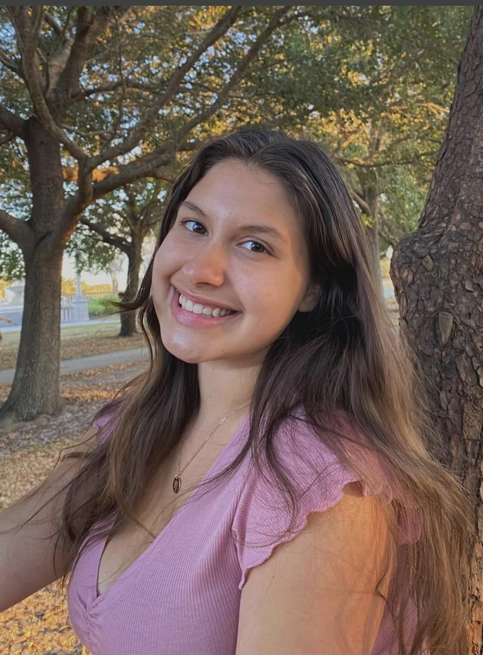
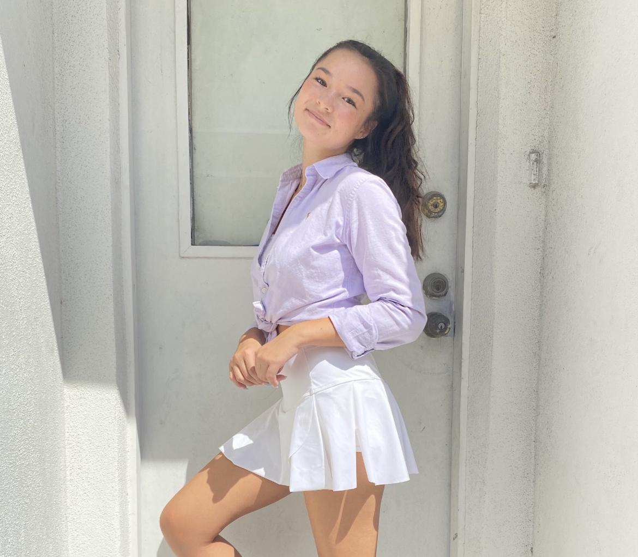
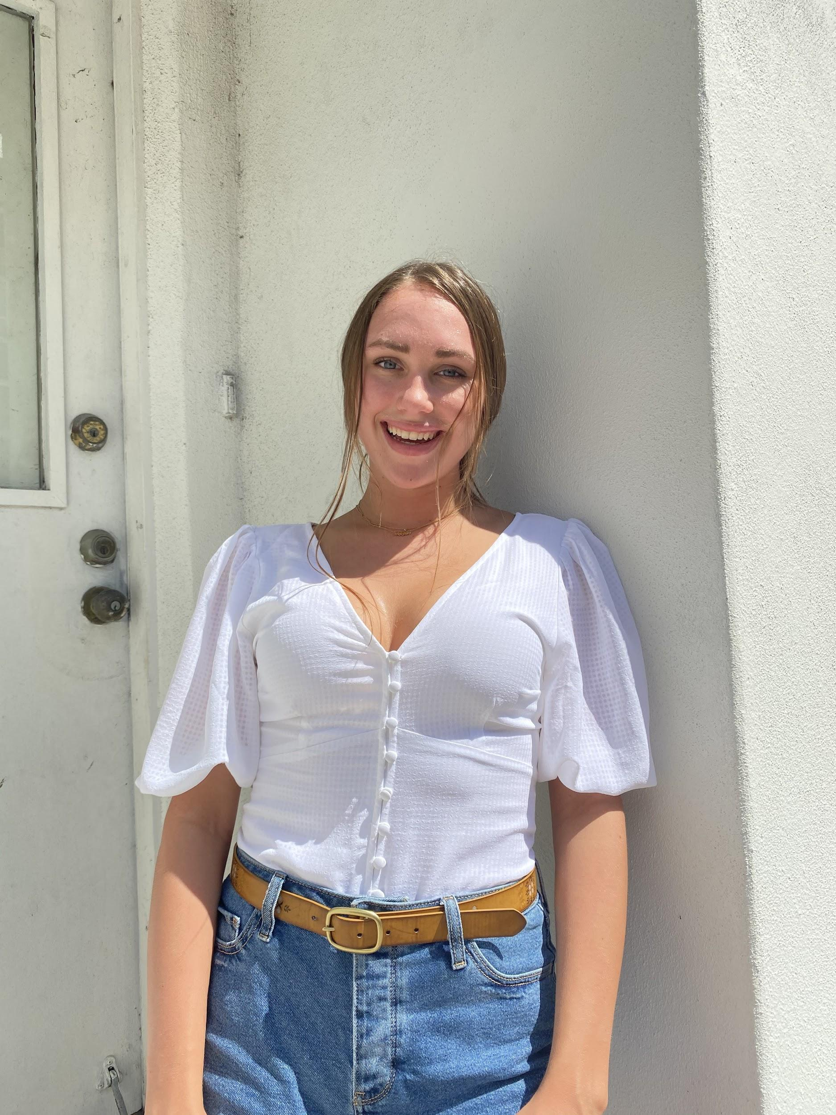
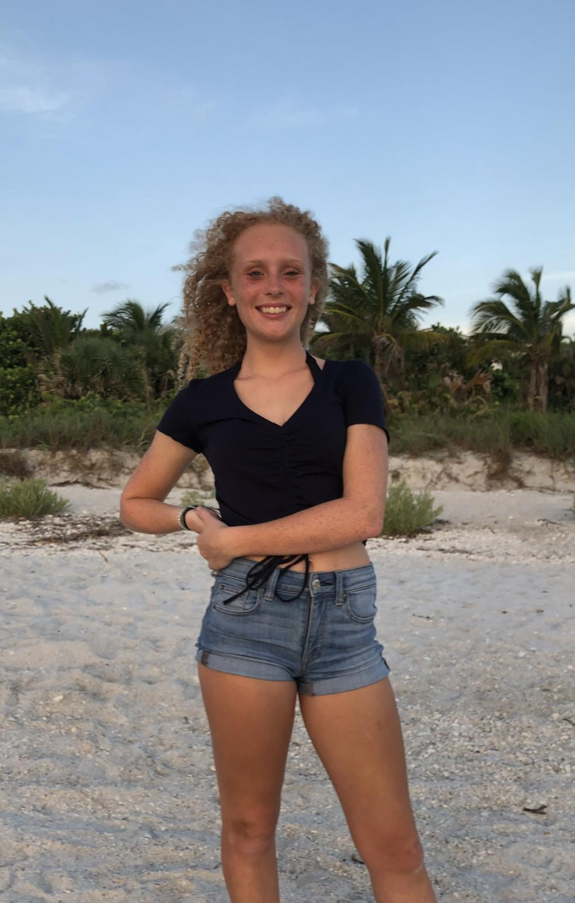
Meet your Senior Class Officers!
President
Lilian Castro
Vice President
Olivia Pobocik
Secretary
Campbell Goff
Treasurer
Peyton Prior

Slide 3
Join our Remind & Instagram
Remind:
Instagram:
Facebook:
Join to keep updated on things happening with Senior Class!
@TCHSSENIORS
@TCHSSENIORS

Slide 4
Homecoming Week:
Class Color
Class Movie
Traditionally, Senior Class chooses PINK
Any ideas are welcome!
We need to choose a movie
Options include: Space Jam, Star Wars, Men in Black, Marvel, etc.

Slide 5
Homecoming Week pt.2
Hallway Designs
Must Include:
Class Color
Movie Theme
Beating Colonial High School
If you’re interested in helping, please let us know!

Slide 6
Homecoming Week pt.3
Parade- 9/29
Float Designs
Truck?
Trailer?
We will be making a committee starting ASAP

Slide 7
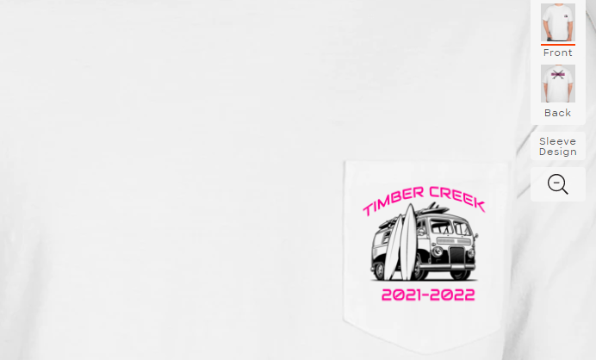
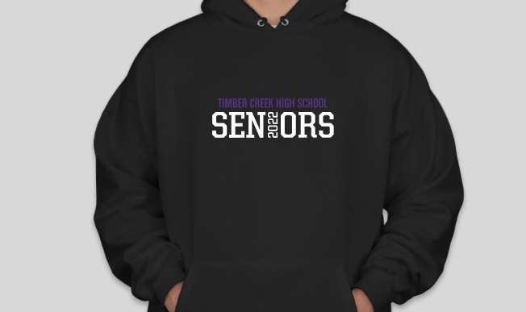
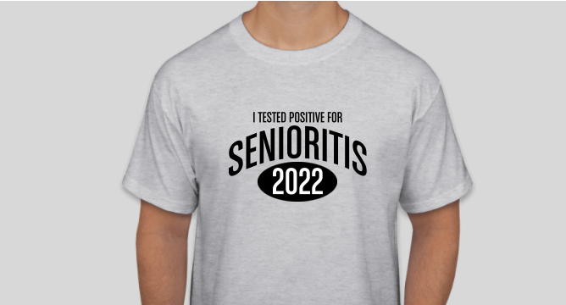
T-shirt Designs
Other designs or suggestions are greatly appreciated!!

Slide 8
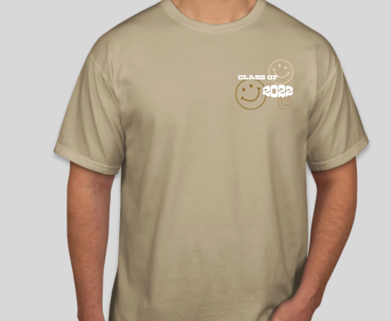
T-Shirt Designs

Slide 9
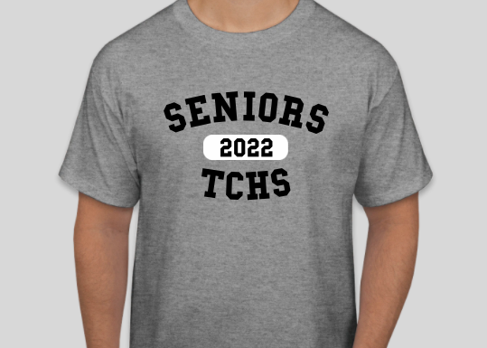
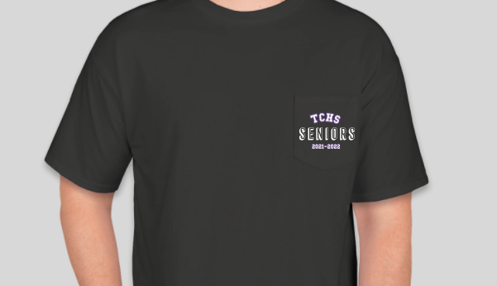
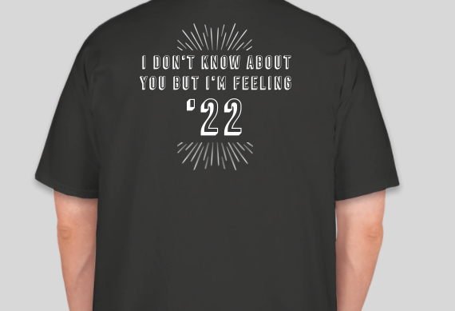
T-Shirt Designs

Slide 10
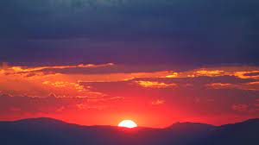
SENIOR SUNRISE
Date: TOMORROW FROM 6:45 to 7:15am
Where: TIMBER CREEK STADIUM

Slide 11
Things to keep in mind during the year:
Our Graduation Song
Other suggestions for events
Any Questions or Concerns

Slide 12
Thanks for Joining!

